Slide 1

ACADEMIC
AUG 2019 – NOV 2019
ACTUATOR SIMULATION
Problem statement
A course project in Micro Electrical Mechanical Devices involved designing and simulating MEMS thermal actuators for understanding how they work.
Deliverable
[1] ONE HOT-ARM ACTUATOR
The design of the model was done in SolidWorks and then the thermal simulations were executed on COMSOL software.
Dimensions and readings were taken based on extensive literature review. Simulations were run for displacement variation with time and temperature variation with time and analyzed for one-arm, two-arm and chevron type actuators
[2] CHEVRON TYPE ACTUATOR

Slide 2
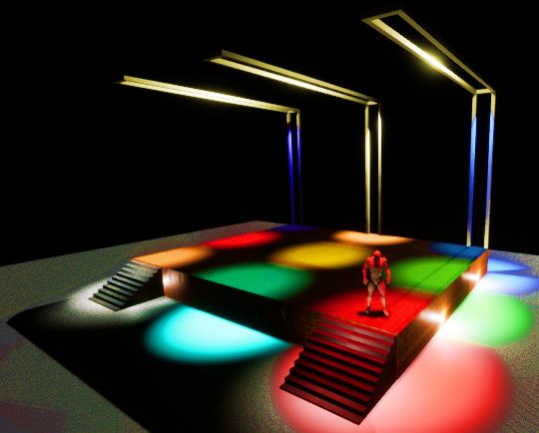
ACADEMIC
AUG 2019 – NOV 2019
MUSIC SYNCED STAGE LIGHTS
Problem statement
As my course project in Computer Graphics and Product Modelling course, I worked in a team of 4 on a project to sync stage lights to music beats.
I used the Unreal Engine software to simulate a stage and control the lights to the beats of music chosen by the user. This would eliminate the need for a middleman to control the stage lights and reduce hours of manual labor.
My Role
[3] STAGE DESIGN IN UNREAL ENGINE

Slide 3
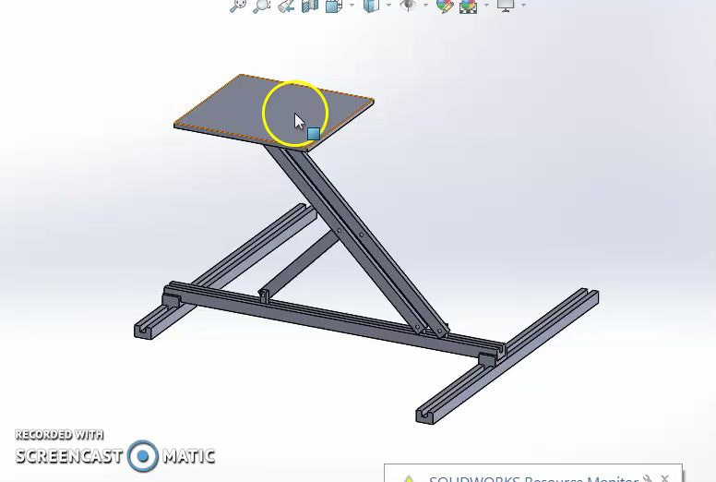
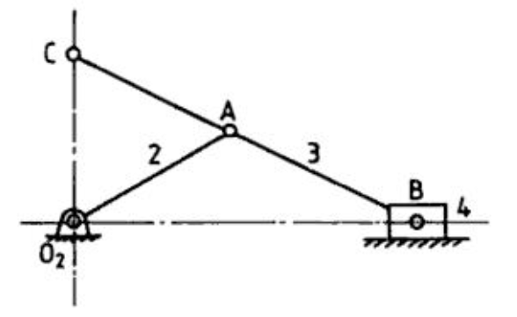
ACADEMIC
AUG 2018 – NOV 2018
SCOTT RUSSELL MECHANISM
As part of my Rapid Product Development course, I used SolidWorks to design the Scott Russell mechanism for 3D Printing in which two degrees of freedom are utilized to generate motion in 3 axis.
Based on the geometry of the linkage, the output motion is a simple sine function of the drive link or a simple harmonic motion. The movement of B is in one axis, while C moves in its perpendicular axis.
It opens up the possibility of incorporating multiple degrees of freedom without incurring additional costs of lead screws for different axis
[4] SCOTT RUSSELL MECHANISM
Link to Video

Slide 4
ACADEMIC
AUG 2018 – NOV 2018
LASER CLADDING MODELLING
Problem statement
As my course project in Manufacturing Processes 2 course, I worked in a team of 4 on a project to model the laser cladding process..
I used Fusion 360 to make the CAD Model and made the complete final report. Additionally, data collected after Heat Affected Zone experiments was reported in Latex and plotted in Excel by me for analysis purposes.
My Role
[5] LASER CLADDING MODELLING DONE IN ANSYS

